Slide 1
Coral Visualizations

Slide 2
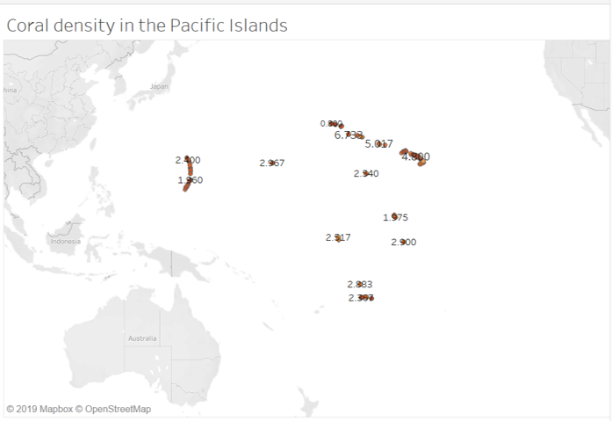

Slide 3
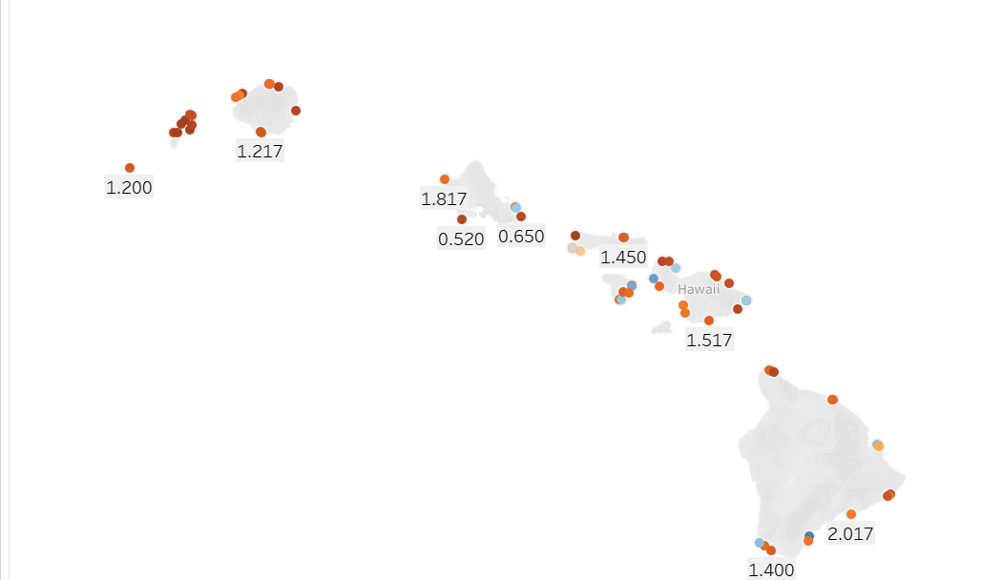
Average Coral Density in Hawaii

Slide 4
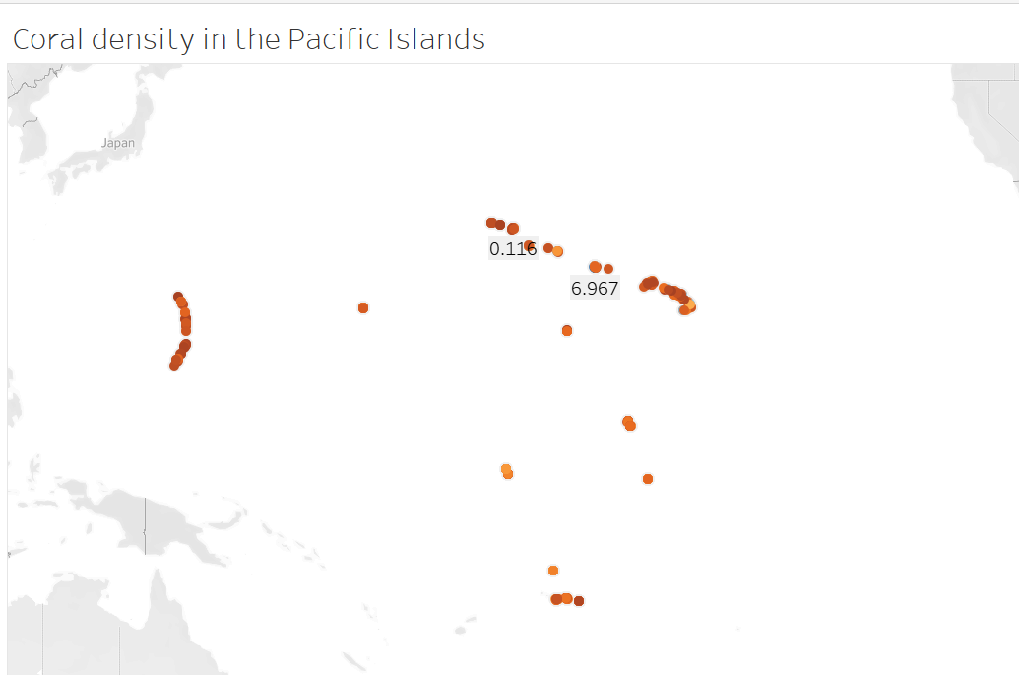
Coral Density Min and Max

